Slide 1

Understanding unbinding kinetics through MLTSA
Pedro J. Buigues, University College London

Slide 2


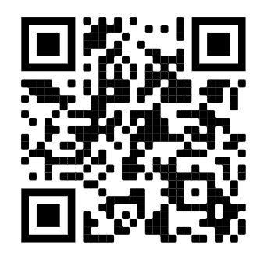

Machine Learning Methods for Understanding Ligand Unbinding Kinetics: MLTSA
Unbinding
Step 1 – Define the CVs
Step 3 – Approximate the TS
Step 2 – Refine
Step 4 – Downhill trajectories
Bound
Step 5 – MLTSA
Optimized
Unbound
Initial
Unbound
Pedro J. Buigues
Rosta Group
Department of Physics and Astronomy
University College London
@pedrojuanbj

Slide 3
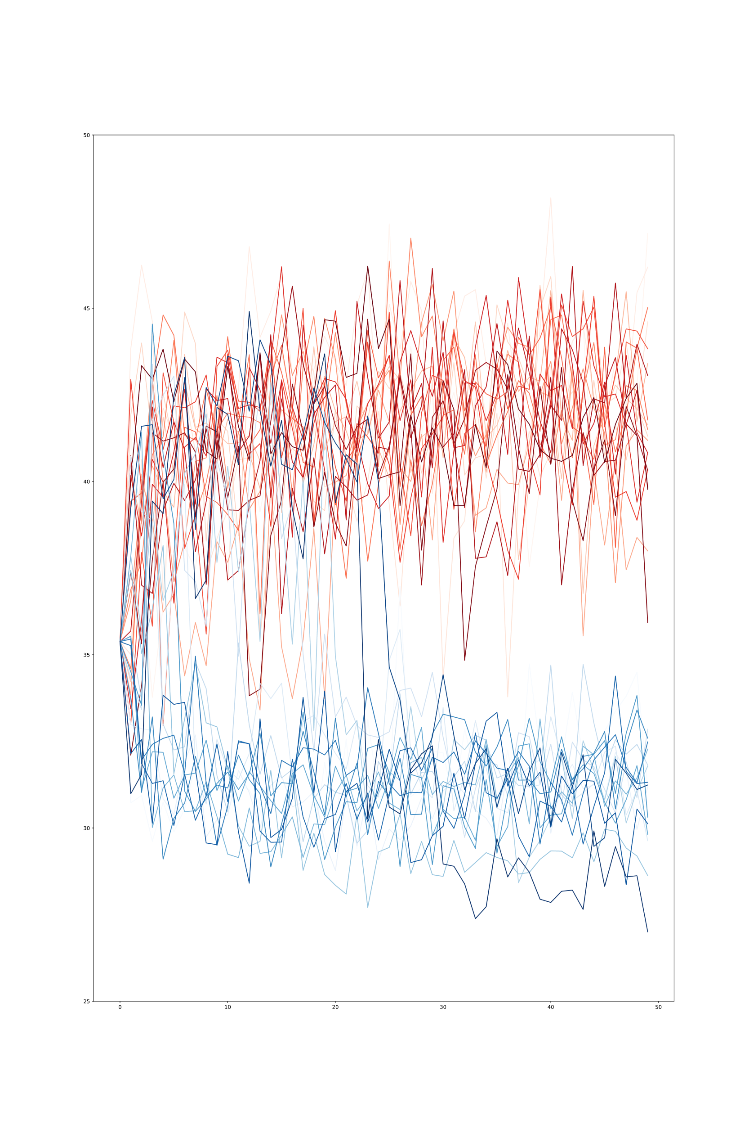
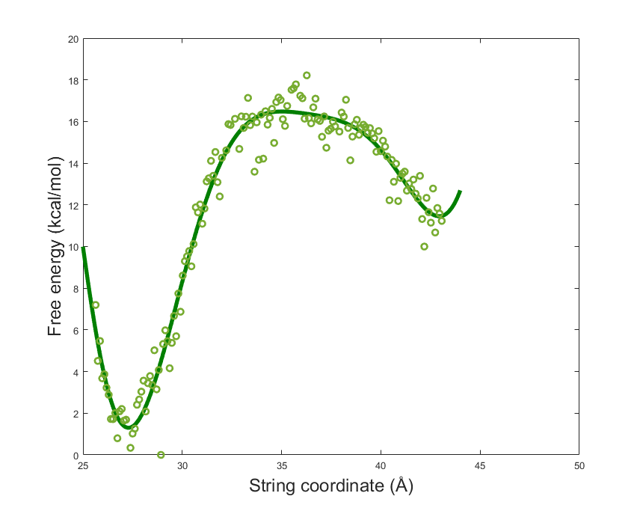
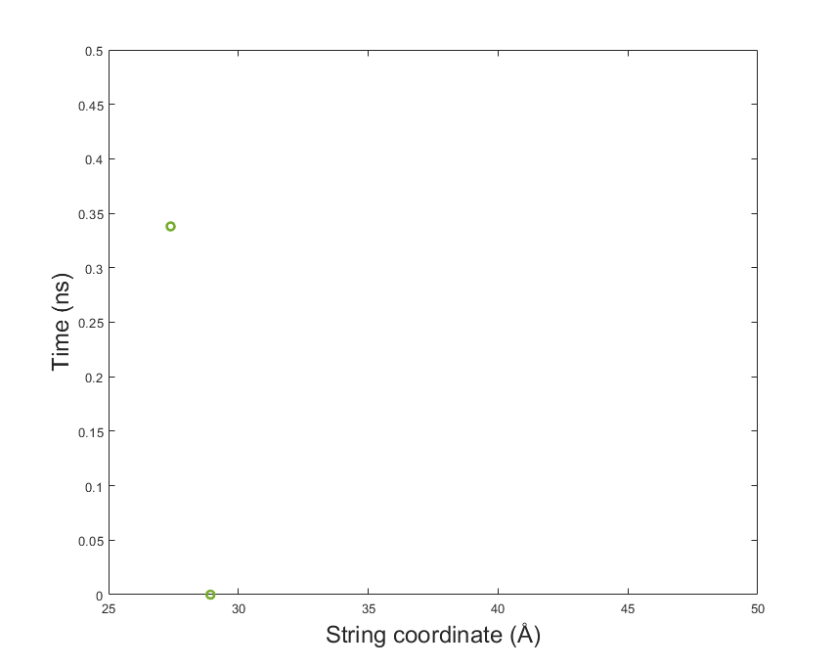
TS
0
2. 5
5
IN
OUT

Slide 4

TS
Generate many downhill simulations to sample the region
ML Analyzed Region
0
1
Find a window that yields a 1:1 ratio of IN/OUT
2. 5
STEP 3
Approximate the TS
5
IN
OUT
Enhanced Sampling Workshop, London, 19-20/12/22

Slide 5
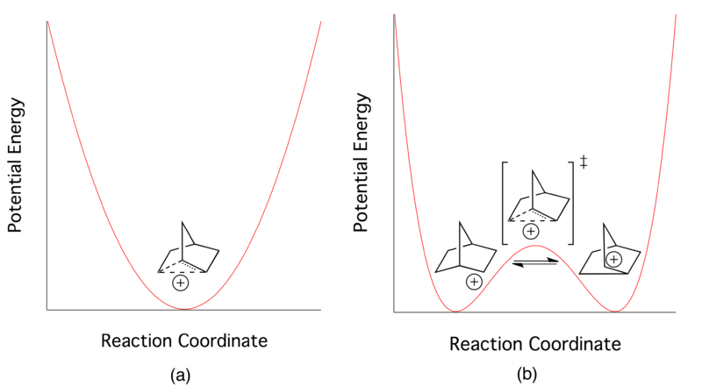

Simplifying the problem -> Analytical model
Single Well (SW)
Double Well (DW)
TS
IN
OUT

Slide 6
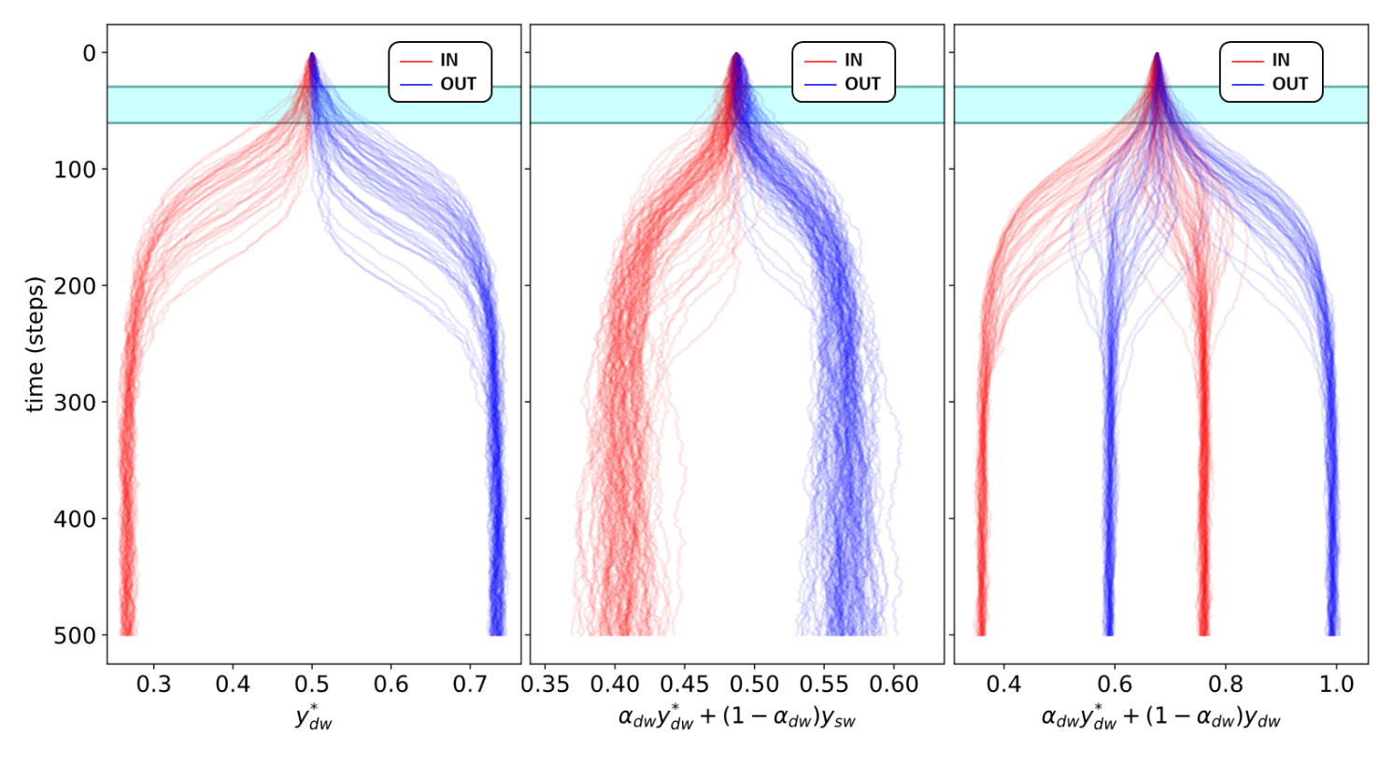
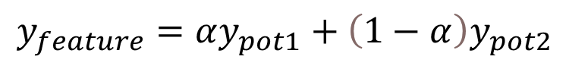
Combining potentials to create features
$$y_{feature}=αy_{pot1}+\left(1−α\right)y_{pot2}$$
DW*
SW + DW*
DW + DW*
ML Analyzed Region

Slide 7

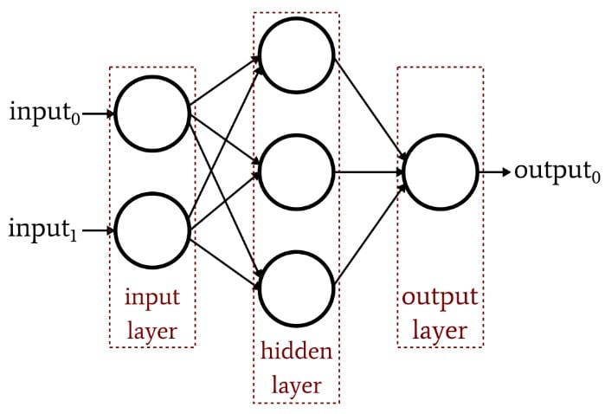
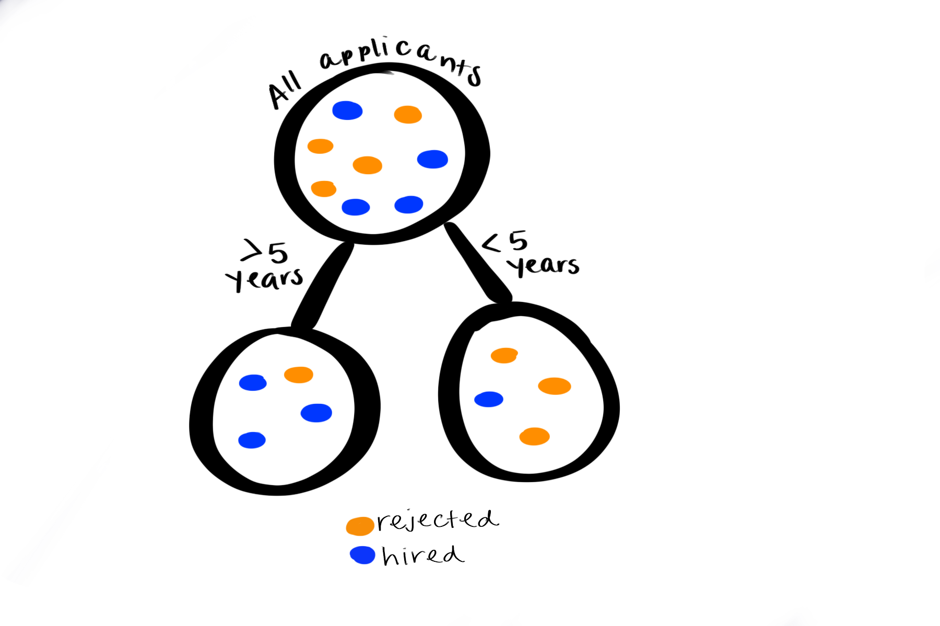
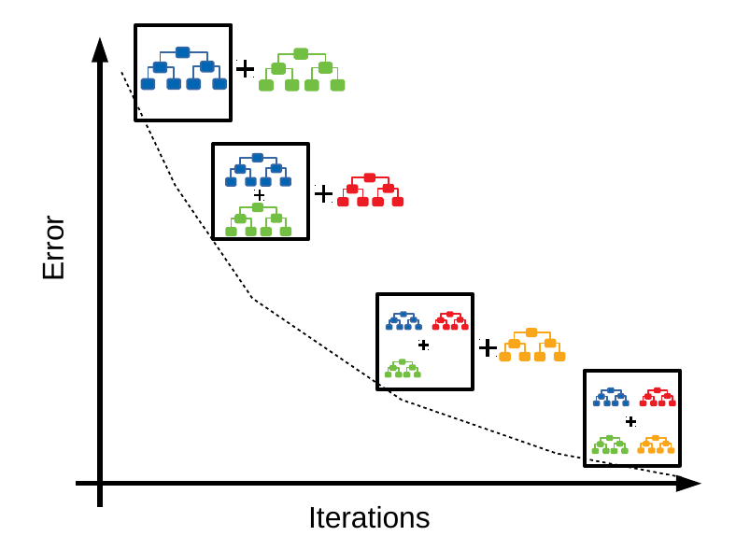
ML models we will use to forecast the outcome
Outcome == Final State (IN/OUT) → Classifiers
Multi-Layer Perceptron Classifier (MLP):
100 Hidden Nodes
Adam Solver (Optimizer)
ReLu Activation Function
Gradient Boosting Decision Tree (GBDT):
500 Decision stumps
Logistic function minimized
MSE error for splitting
Decision Trees
Gradient Boosting
IN
OUT

Slide 8
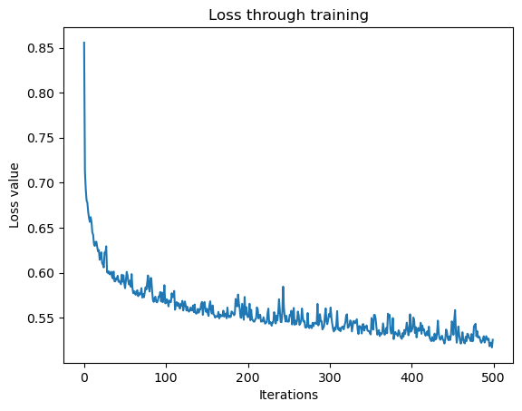
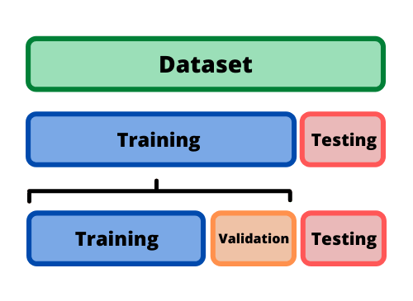
Training for the models
Train until convergence
Select data at early steps (10-50)
Split data onto Training/Test sets
Once trained and performing good on test set, we move to the analysis

Slide 9
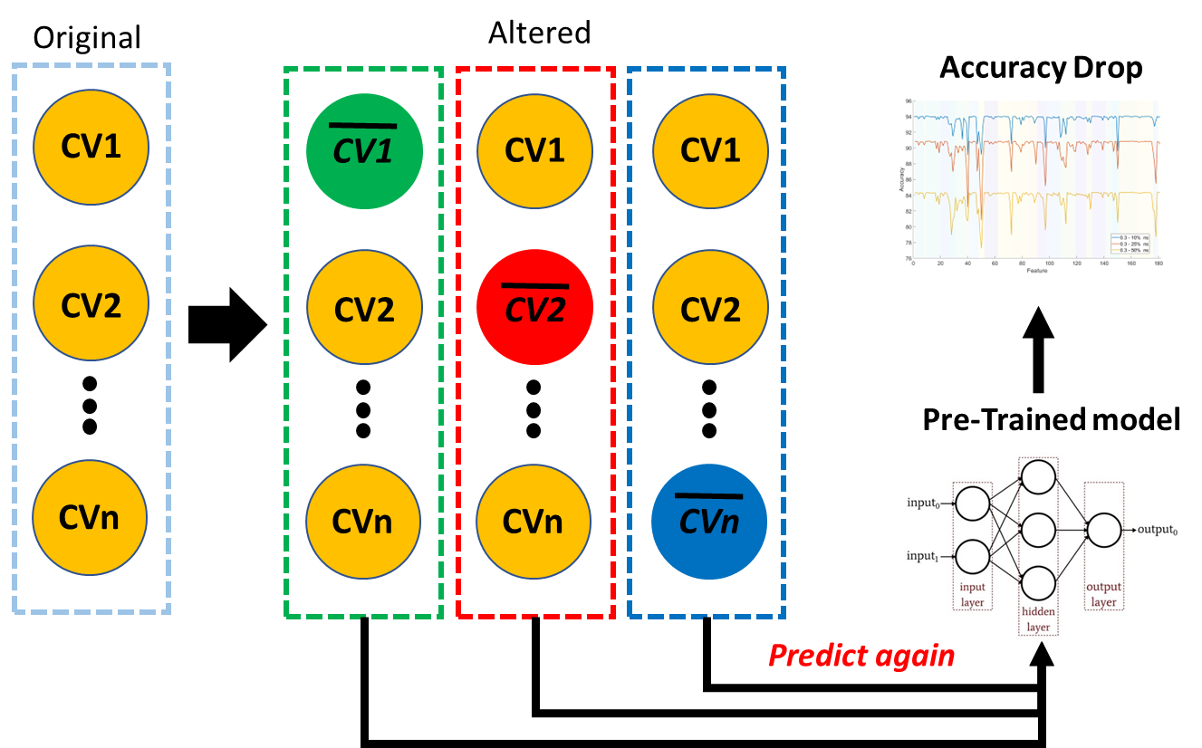
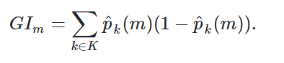
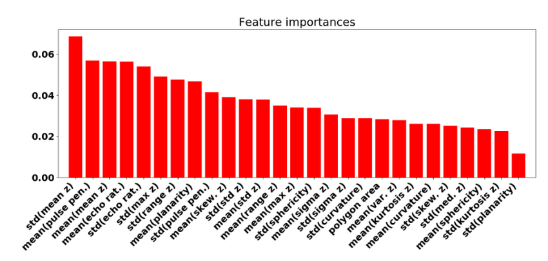
Model interpretation (MLTSA)
MLP
STEP 5
Machine Learning Transition State Analysis
GBDT
Accuracy Drop*
Gini Feature Importance

Slide 10
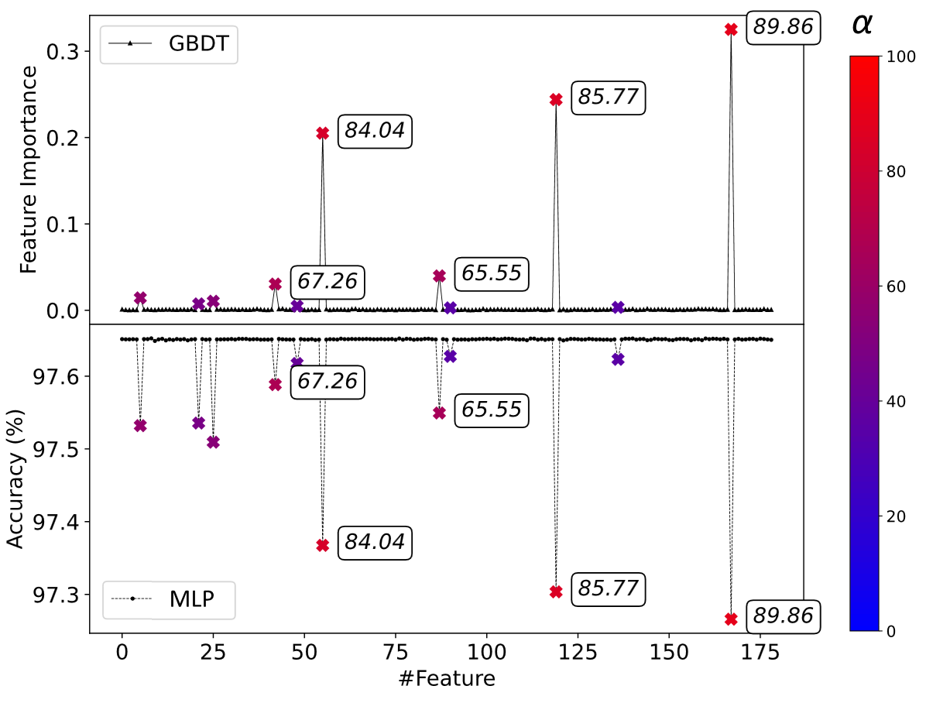

IT WORKS!

Slide 11
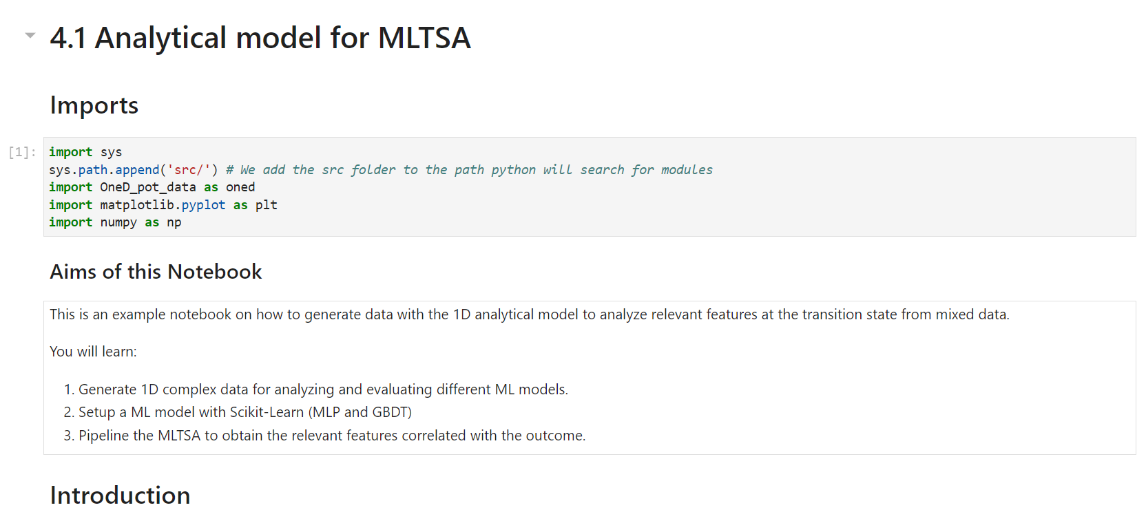
We will attempt 4.1 Now

Slide 12
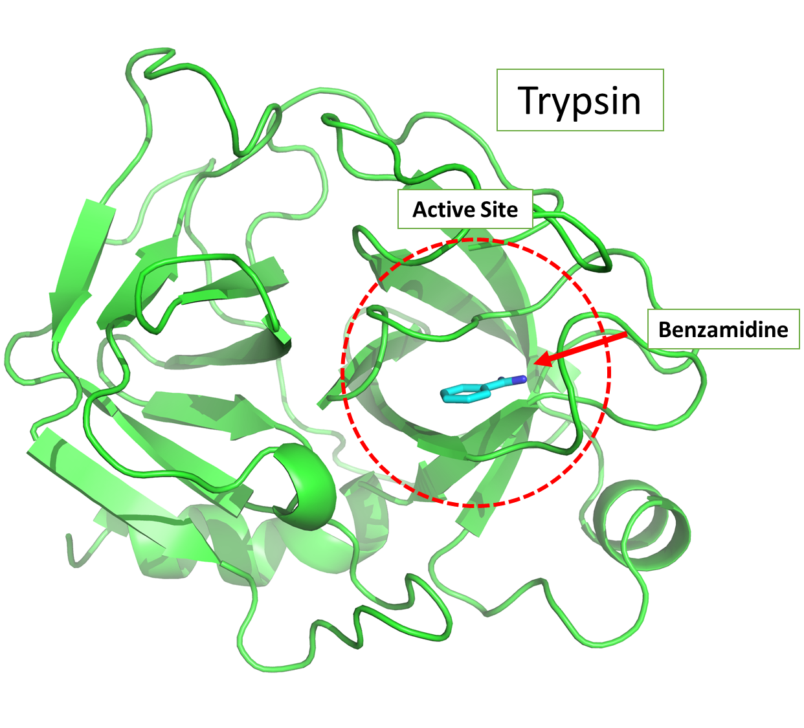
What is our protein dataset?
Approximated
~150 5ns Downhill Simulations
Label outcomes as IN / OUT
TS
Dataset (X,Y)
For our example:
Closest Ligand-Protein Distances for each residue
Create CVs

Slide 13
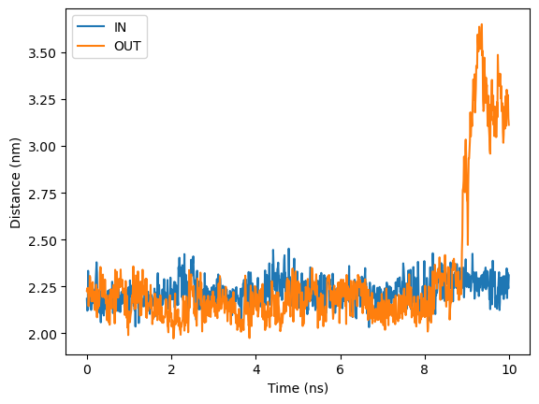
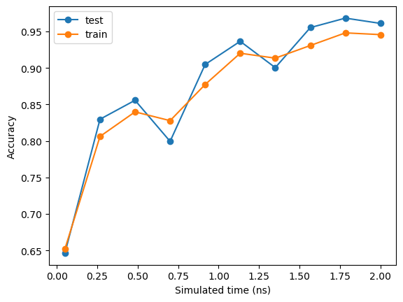
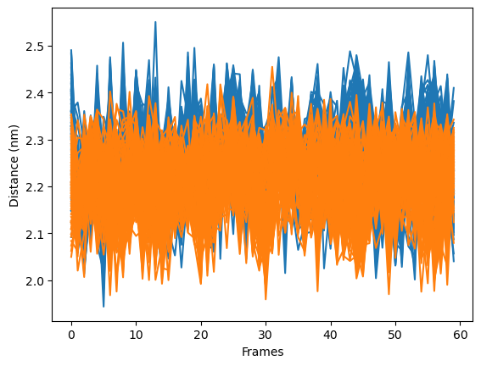
All data – 10ns
We will train around this time frame
Selected time frame

Slide 14
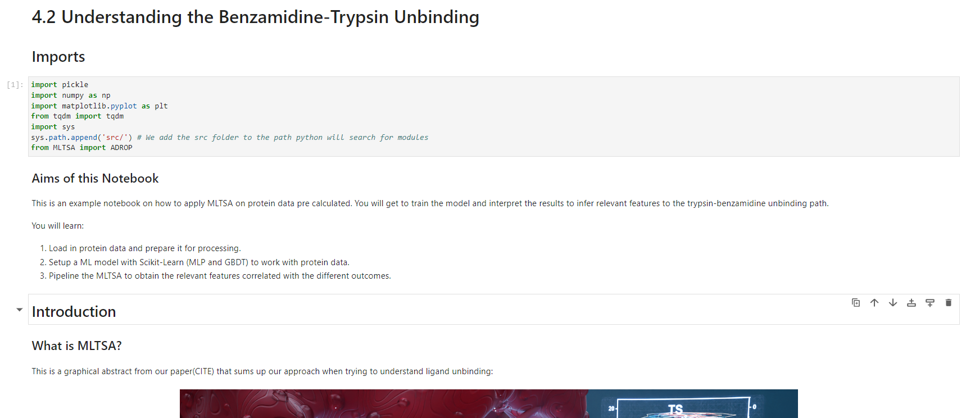
We will attempt 4.2 Now

